Slide 2

2
4
Lesson 24
Probability II-Complementary and Independent Events

Slide 3
Chapter 1
Complementary Probability

Slide 4
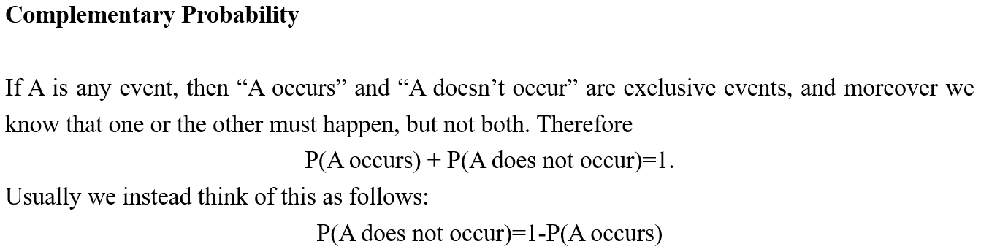
Lead in

Slide 5
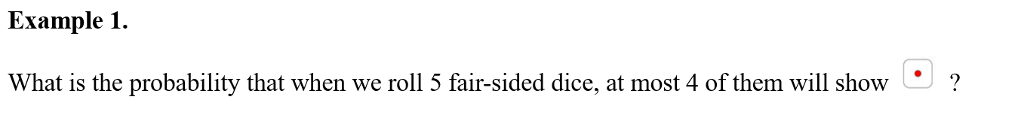
Example

Slide 6
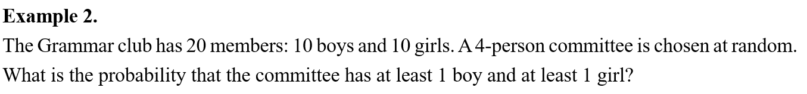
Example

Slide 7
Chapter 2
Independent Events

Slide 8
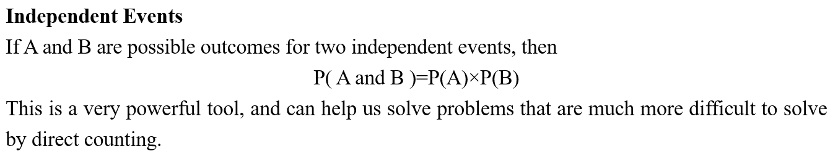
Lead in

Slide 9
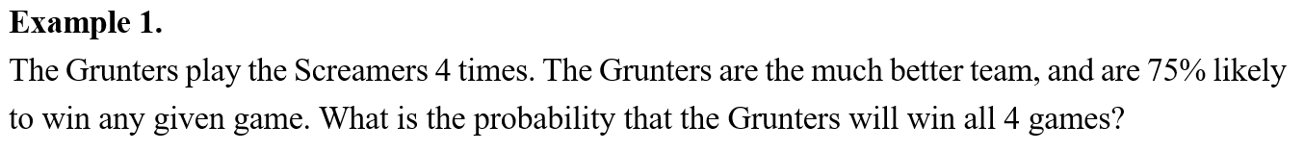
Example

Slide 10
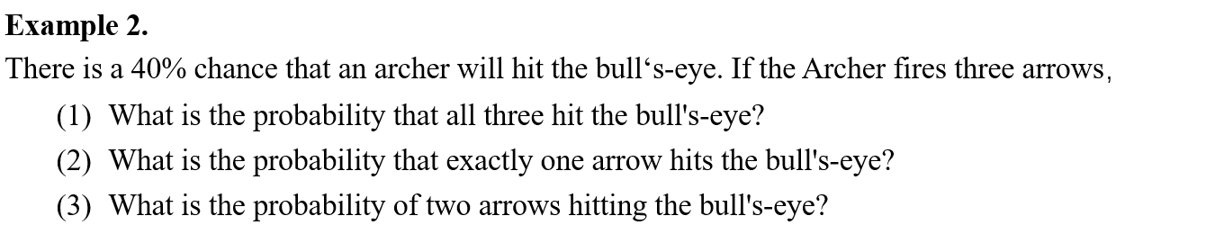
Example

Slide 11
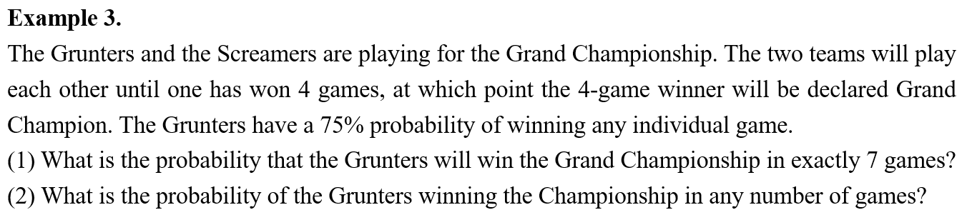
Example

Slide 12
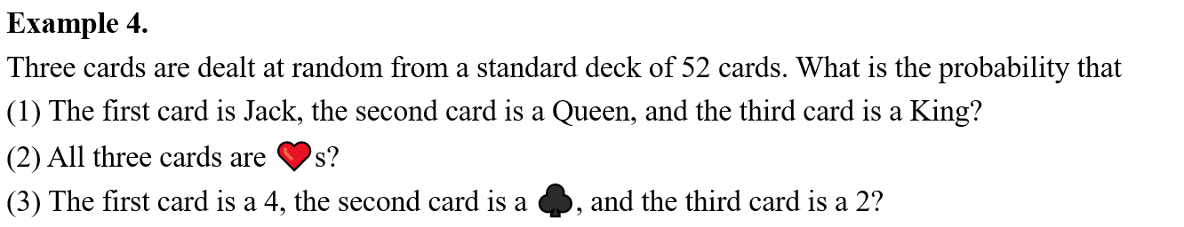
Example

Slide 13
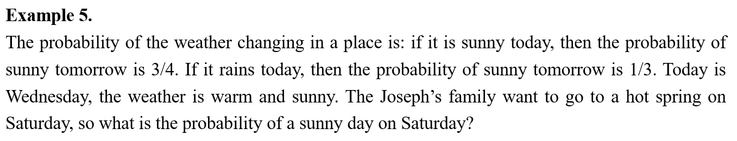
Example

Slide 14
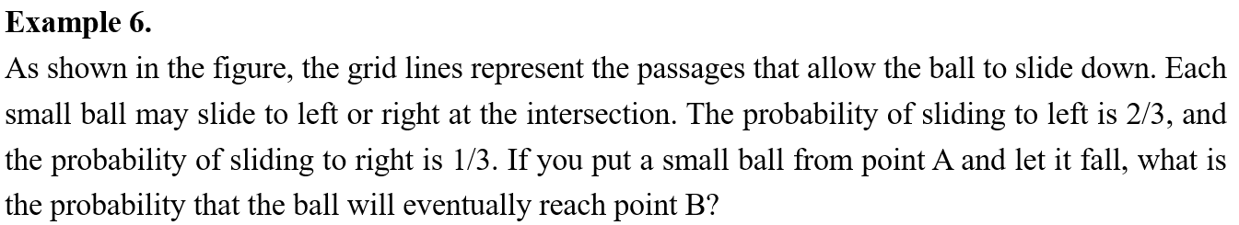
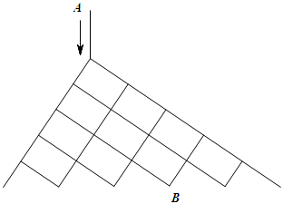
Example

Slide 15
Chapter 3
Casework & Complementary

Slide 16
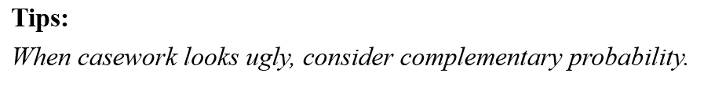
Lead in

Slide 17
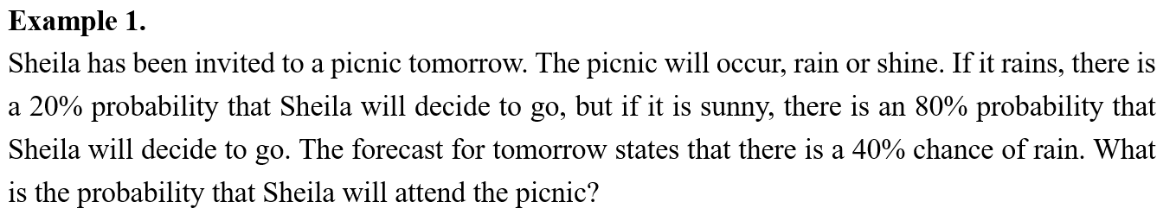
Example

Slide 18
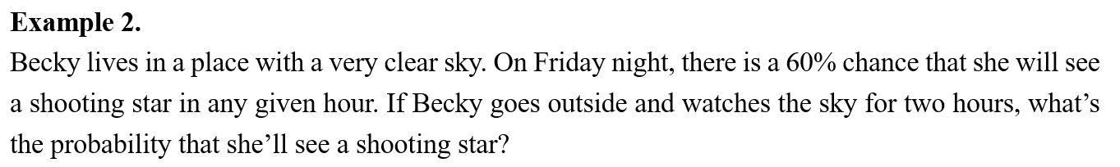
Example

Slide 19
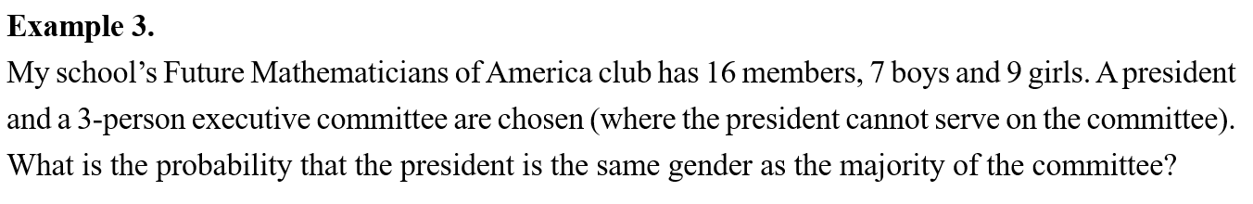
Example

Slide 20
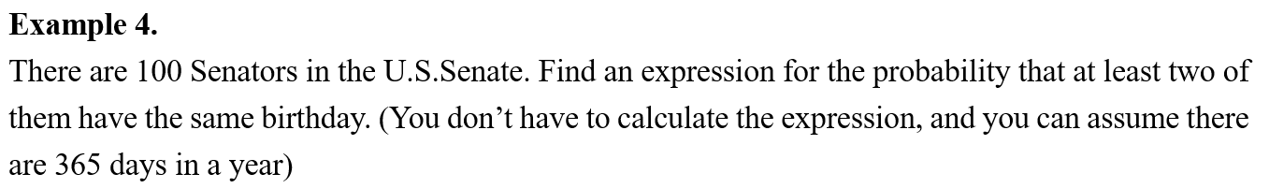
Example

Slide 21
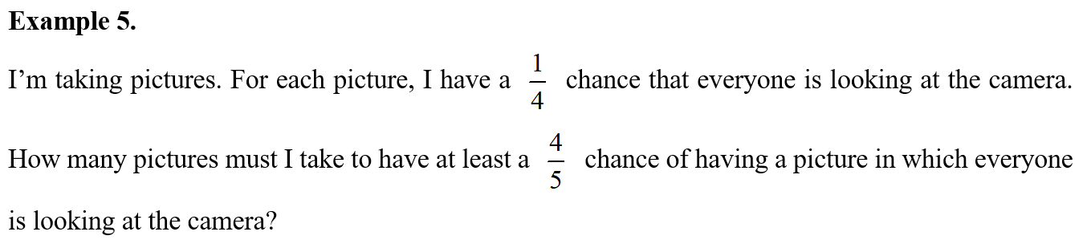
Example

Slide 22
Chapter 4
Past Problem of AMC10

Slide 23
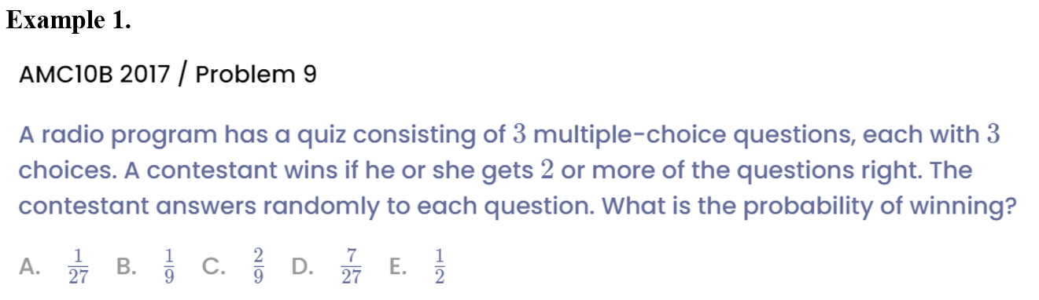
Example

Slide 24
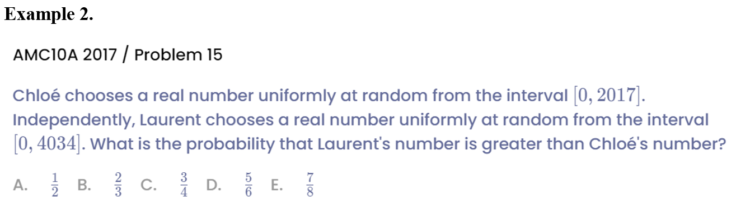
Example

Slide 25
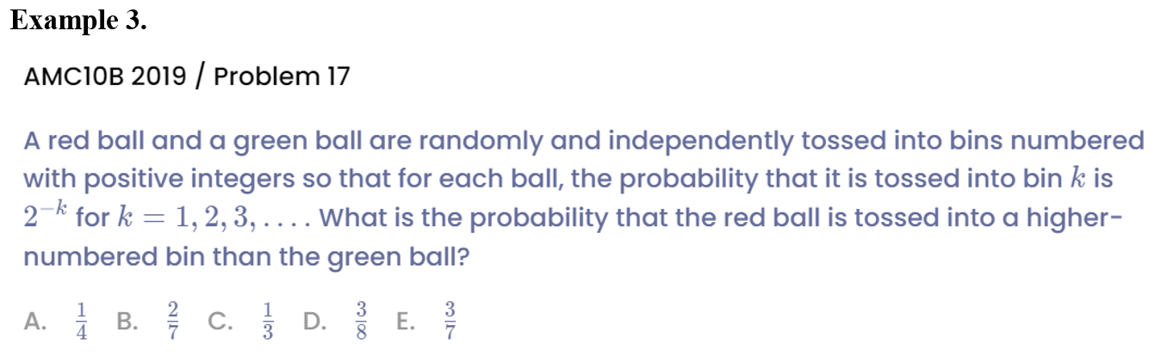
Example

Slide 26
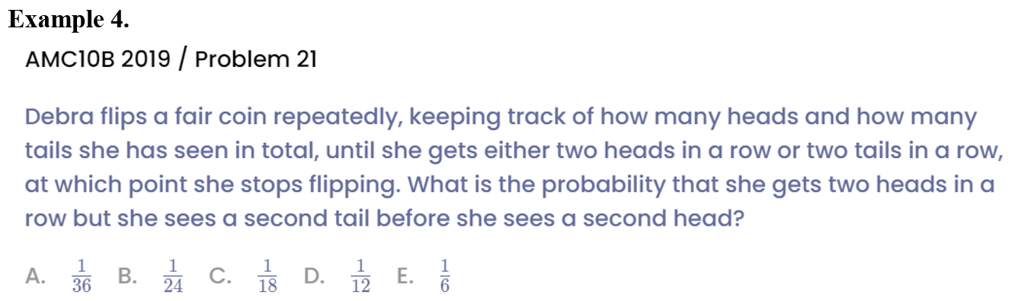
Example

Slide 27
See You Next Time!

